Slide 1
Magic Show Solution

Slide 2
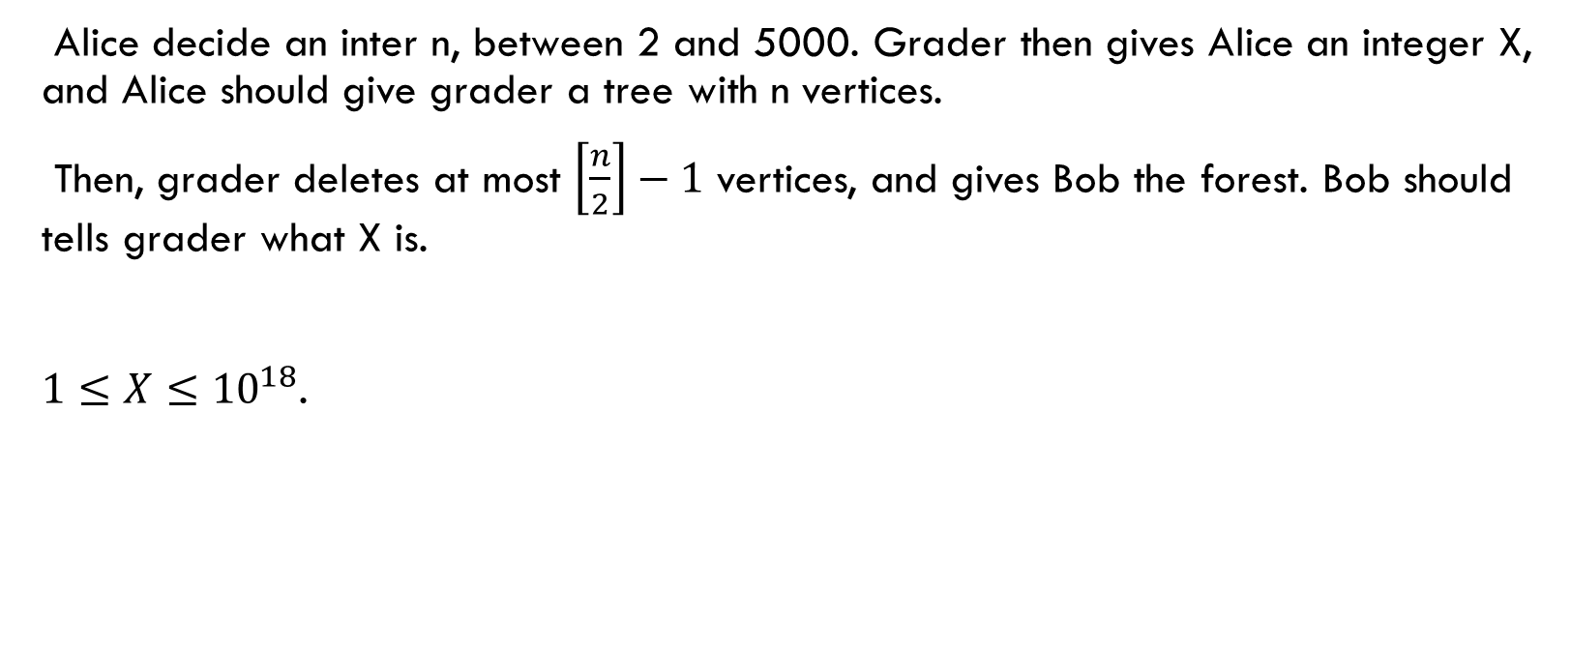
Statement
Alice decide an inter n, between 2 and 5000. Grader then gives Alice an integer X, and Alice should give grader a tree with n vertices.
Then, grader deletes at most $\left[\frac{n}{2}\right]−1$ vertices, and gives Bob the forest. Bob should tells grader what X is.
$1≤X≤{10}^{18}$.

Slide 3
Subtask 1
X<=5000
Alice can just make a star graph whose centroid is X. Then Bob can identify what the centroid was, and can guess X correctly.

Slide 4
Subtask 2
We can convert this subtask to transport two integers x,y, between 1 and 5000. First, connect all the vertices in 1 and 1666 to x. Then, connect all the vertices between 1667 and 3333 to y. Finally, connect all vertices between 3334 and 5000 to x+y mod 5000.
If there is a cycle in this graph, then delete any edges in the cycle, until the graph has no cycle.
After that, connect components in the graph, in any ways.

Slide 5
Subtask 2
Then we will receive the graph. There would be at least two vertices with more than 5 degree(very roughly), because by deleting at most 2499 edges, it’s impossible to make two vertices among x,y,x+y, to have degree lesser than 5.
Thus, we can know two values between x,y,x+y mod 5000, and know which value corresponds to them.
Then, we can restore x and y, then we can guess the X in original problem, correctly.

Slide 6
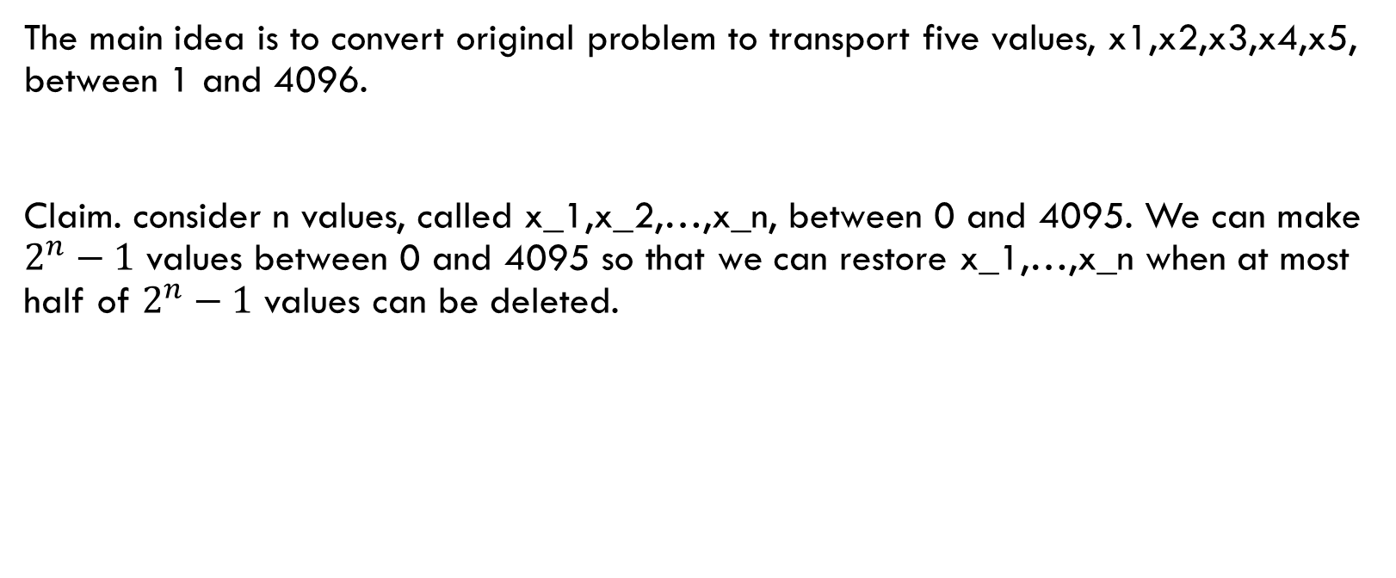
fulltask
The main idea is to convert original problem to transport five values, x1,x2,x3,x4,x5, between 1 and 4096.
Claim. consider n values, called x_1,x_2,…,x_n, between 0 and 4095. We can make $2^{n}−1$ values between 0 and 4095 so that we can restore x_1,…,x_n when at most half of $2^{n}−1$ values can be deleted.

Slide 7
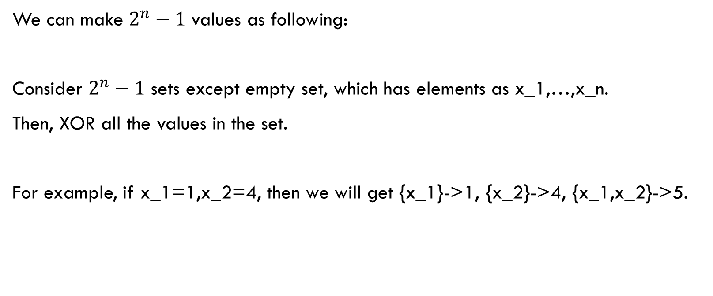
Why?
We can make $2^{n}−1$ values as following:
Consider $2^{n}−1$ sets except empty set, which has elements as x_1,…,x_n.
Then, XOR all the values in the set.
For example, if x_1=1,x_2=4, then we will get {x_1}->1, {x_2}->4, {x_1,x_2}->5.

Slide 8
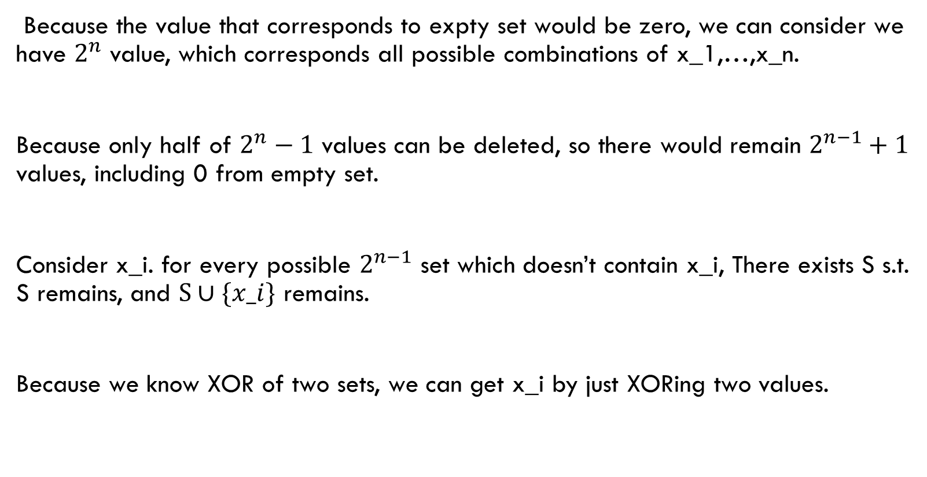
Why?
Because the value that corresponds to expty set would be zero, we can consider we have $2^{n}$ value, which corresponds all possible combinations of x_1,…,x_n.
Because only half of $2^{n}−1$ values can be deleted, so there would remain $2^{n−1}+1$ values, including 0 from empty set.
Consider x_i. for every possible $2^{n−1}$ set which doesn’t contain x_i, There exists S s.t. S remains, and $S∪\{x_i\}$ remains.
Because we know XOR of two sets, we can get x_i by just XORing two values.

Slide 9
Why?
So we can restore all the values, and Claim could be proved.

Slide 10
fulltask
So, it’s enough to transport 31 values(we will call them a_k, where 1<=k<=31.) between 1 and 4096 to solve entire problem.
To do that, first, we will set n=4991. I will explain why this setting is required.
for each k, connect vertices between 160(k-1)+1 to 160k to (k th value)th vertex.

Slide 11
fulltask
So, it’s enough to transport 31 values between 1 and 4096 to solve entire problem.
To do that, first, we will set n=4991. I will explain why this setting is required.
for each k, connect vertices between 161(k-1)+1 to 161k to (k th value)th vertex.
If there exist some cycles, then delete any edges in the cycle, until there is no cycle.
What we can notice is that, the original graph was functional graph, so in this procedure, for each vertices, degree decreases at most 1.

Slide 12
Fulltask
Then, we will get forests with some components, which has size not smaller than 160.
Thus, we can select distinct leaves from each components, and connect them moderately so that the vertices we selected has degree lesser than 3.
So, it’s the end of Alice’s tree construction.

Slide 13
Fulltask
Then, How can bob know 16 values among 31 original values?
In The tree bob have received, for 1<=k<=31, we will call k good if there exists some vertex V, so that in [161(k-1)+1,161k], there exists at least 2 vertices adjacent to V.
Before transforming, every k is good, and there are at least 159 vertices adjacent to V.
What we can observe is that, for each k, V is unique.

Slide 14
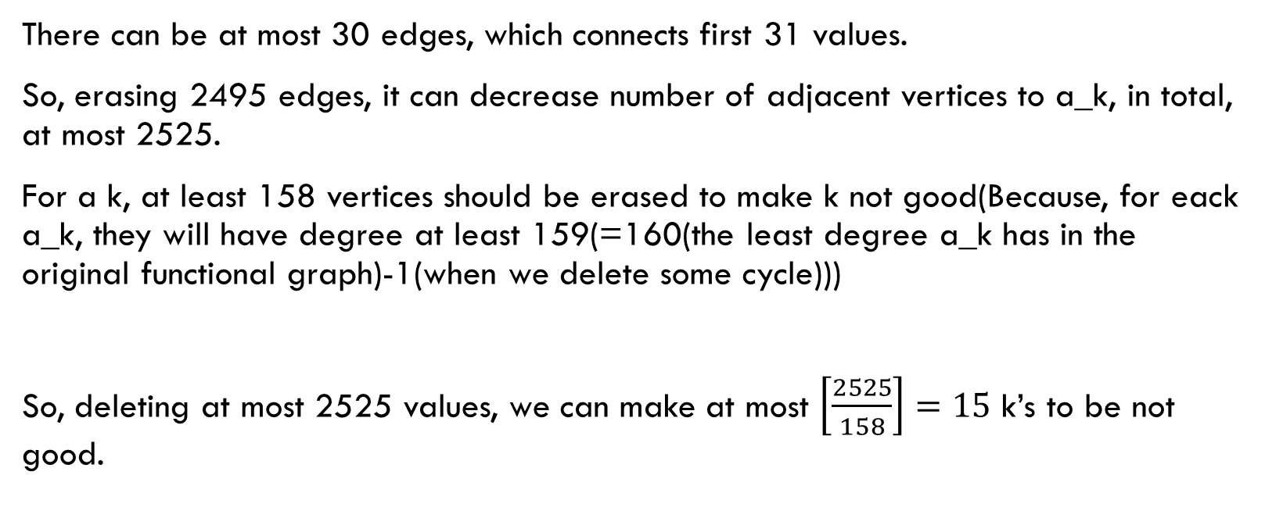
Fulltask
There can be at most 30 edges, which connects first 31 values.
So, erasing 2495 edges, it can decrease number of adjacent vertices to a_k, in total, at most 2525.
For a k, at least 158 vertices should be erased to make k not good(Because, for eack a_k, they will have degree at least 159(=160(the least degree a_k has in the original functional graph)-1(when we delete some cycle)))
So, deleting at most 2525 values, we can make at most $\left[\frac{2525}{158}\right]=15$ k’s to be not good.

Slide 15
fulltask
So, there exists 16 good k’s between 1 and 31.
Then, we can just apply the Claim, and then we can decode X. So, the entire problem could be solved.

Slide 16
Why n=4991 needed?
if we set n=5000, then 2499 eddges can be deleted, and 2529/158 is bigger than 16.
In more detail. increase of n is asymptotically benefit for solving problem. But, this effect occurs because as n increases, then denominator increases “sometimes”. So, if n decreases, and denominator doesn’t decreases, then numerator decreases, so it can be benefit, sometimes.

